Slide 1

SAP Cloud Platform
Mobile Services
Akarsh Sidhartha, Sandeep T D S
August 6th 2019
Notes:
We live in a time of accelerated change. In this competitive environment, it’s more important than ever for companies to focus on their core business, to differentiate themselves from their competitors and to provide products and services that deliver immediate value to their customers. In this session you will learn about the strategic role of SAP Cloud in supporting customers & partners in their digital transformation journeys and becoming intelligent enterprises.

Slide 2
Disclaimer
The information in this presentation is confidential and proprietary to SAP and may not be disclosed without the permission of SAP. Except for your obligation to protect confidential information, this presentation is not subject to your license agreement or any other service or subscription agreement with SAP. SAP has no obligation to pursue any course of business outlined in this presentation or any related document, or to develop or release any functionality mentioned therein.
This presentation, or any related document and SAP's strategy and possible future developments, products and or platforms directions and functionality are all subject to change and may be changed by SAP at any time for any reason without notice. The information in this presentation is not a commitment, promise or legal obligation to deliver any material, code or functionality. This presentation is provided without a warranty of any kind, either express or implied, including but not limited to, the implied warranties of merchantability, fitness for a particular purpose, or non-infringement. This presentation is for informational purposes and may not be incorporated into a contract. SAP assumes no responsibility for errors or omissions in this presentation, except if such damages were caused by SAP’s intentional or gross negligence.
All forward-looking statements are subject to various risks and uncertainties that could cause actual results to differ materially from expectations. Readers are cautioned not to place undue reliance on these forward-looking statements, which speak only as of their dates, and they should not be relied upon in making purchasing decisions.

Slide 3
The digital era is evolving into the intelligence era
Mainframe & PCs
Client Server & Internet
Cloud, Mobile & Big Data
Intelligent Technologies
Industrial Automation
Business Process Automation
Digital Transformation
Intelligent Enterprise
Transistors & silicon revolution
Large-scale mainframe computing adoption
Emergence of PCs
Plant floor automation
Widespread PC adoption
Broadband Internet
ERP & business process technologies
Mobile & smartphone ubiquity
Cloud computing
Social networks
Big Data
Machine learning & artificial intelligence
IoT & distributed computing
Blockchain

Slide 4










SAP Strategy: Enable the Intelligent Enterprise SAP Cloud Platform as Key Component of Digital Transformation
Manufacturing
& Supply Chain
Digital Core
People
Engagement
Customer
Experience
Network & Spend
Management
Intelligent Suite
1
Intelligent Suite
Intelligent Technologies
2
Intelligent Technologies
AI/ML | IoT | Analytics
3
Digital Platform
Digital Platform
Data
Management
Cloud
Platform

Slide 5



Agility. The cloud is your fastest track to continuous innovation
Time to market
Fast Innovation cycles
Idea
Minimum viable product
Continuous Innovation
Total cost of development (TCD)
Continuous delivery
25 – 50% Improvement in effective coding time
20% Improvement in operational efficiency

Slide 6


















UI5 / Fiori
Mobile
Co-Pilot
WebIDE/ Cockpit
App Center/ Marketplace
APIs (via SAP API Business Hub)
Master data objects²
Commerce
Globalization
Master Data
Rates & Measures
LOBs & Industries
…
Analytics
Machine Learning
Blockchain
IoT
Data Intelligence
Data Management
Big Data
Business Suite
BW
Integration & Orchestration
Data Privacy & Security
UX & Mobile
Dev XP & DevOps
Collaboration
NEO
²
¹
Data Center
Google Cloud Platform
2
1) BETA , 2) planned innovations / future direction

Slide 7


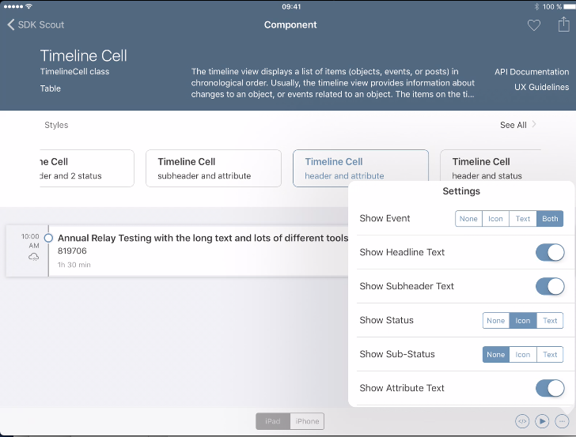


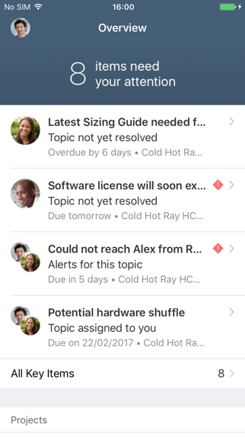
SAP Cloud Platform SDK for iOS
Consistent user experience across iOS and Fiori
Native integration with SAP Cloud Platform Mobile Services enables automated features like push, offline, and app authentication
Part of a broader strategic relationship with Apple, including joint community enablement

Slide 8

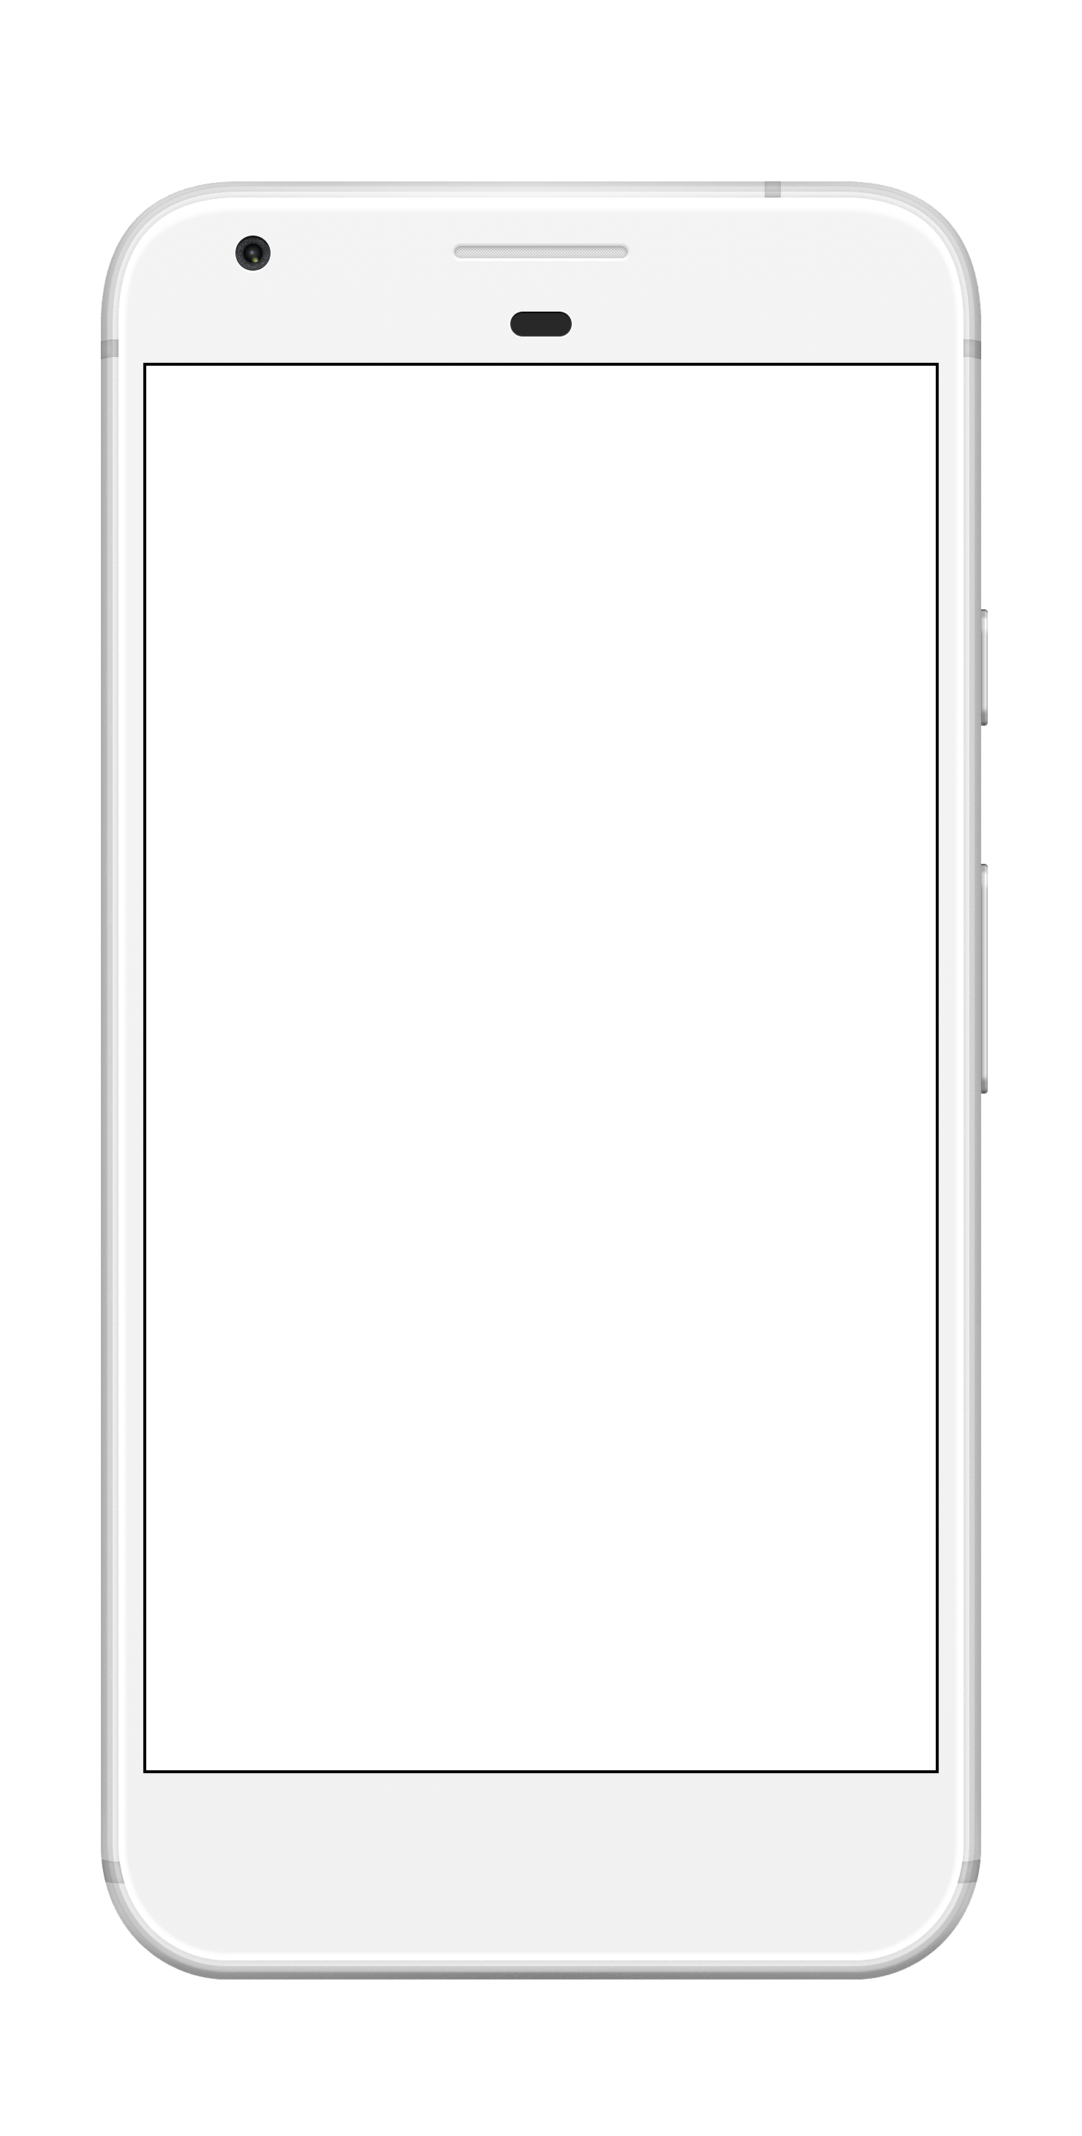
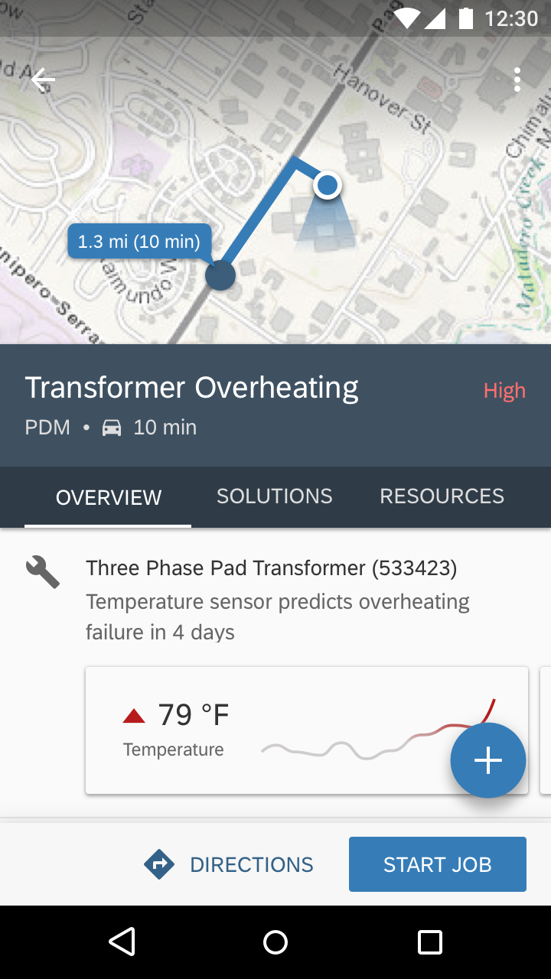
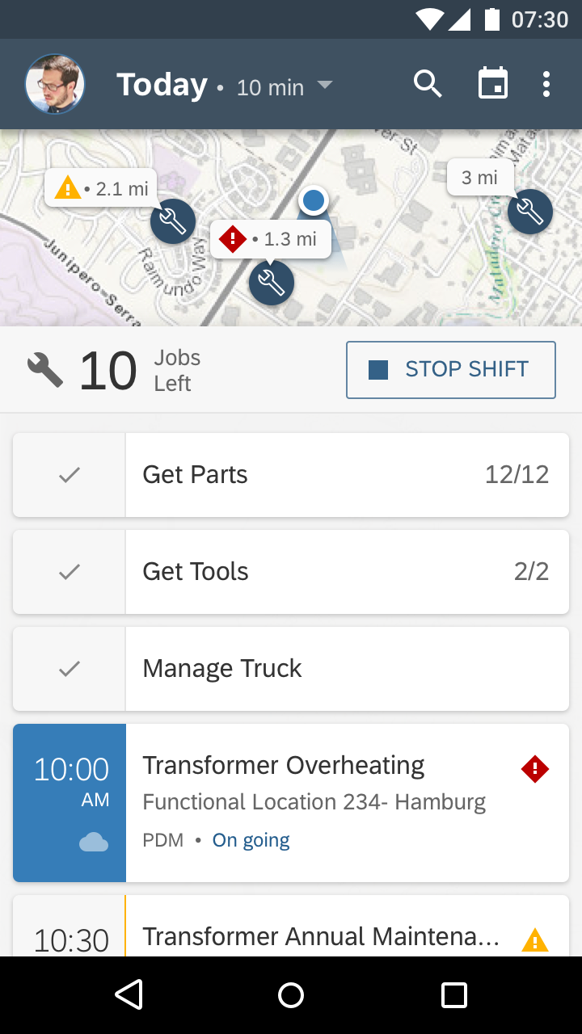
SAP Cloud Platform SDK for Android
Consistent user experience across Android and Fiori
Native integration with SAP Cloud Platform Mobile Services enables automated features like push, offline, and app authentication
Part of a broader strategic relationship with Google, including joint community enablement

Slide 9

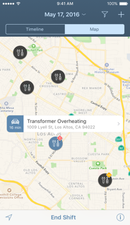

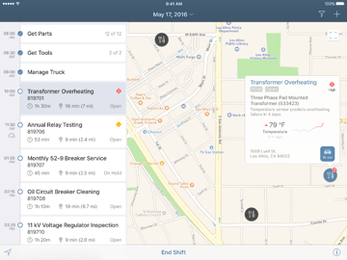
SAP Cloud Platform Mobile Development Kit
Code-free tool that speeds the process of creating applications for mobile platforms
Cross-platform, running on Android and iOS
Increase capacity to meet mobile app demand without professional developers
Optimize select pre-built SAP apps by customizing them to meet unique business needs

Slide 10
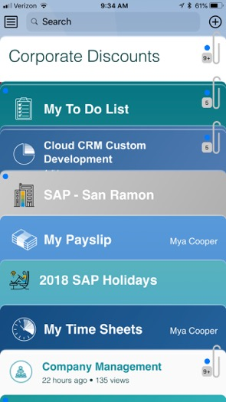
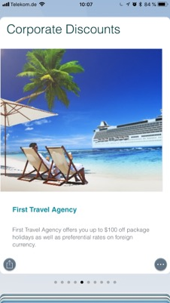
SAP Cloud Platform Mobile Cards
Provides instant content, context, availability with always available cards
Deploy content from Smart Template apps. No coding required
Reduce costs by mobilizing data in familiar Wallet style apps without development

Slide 11


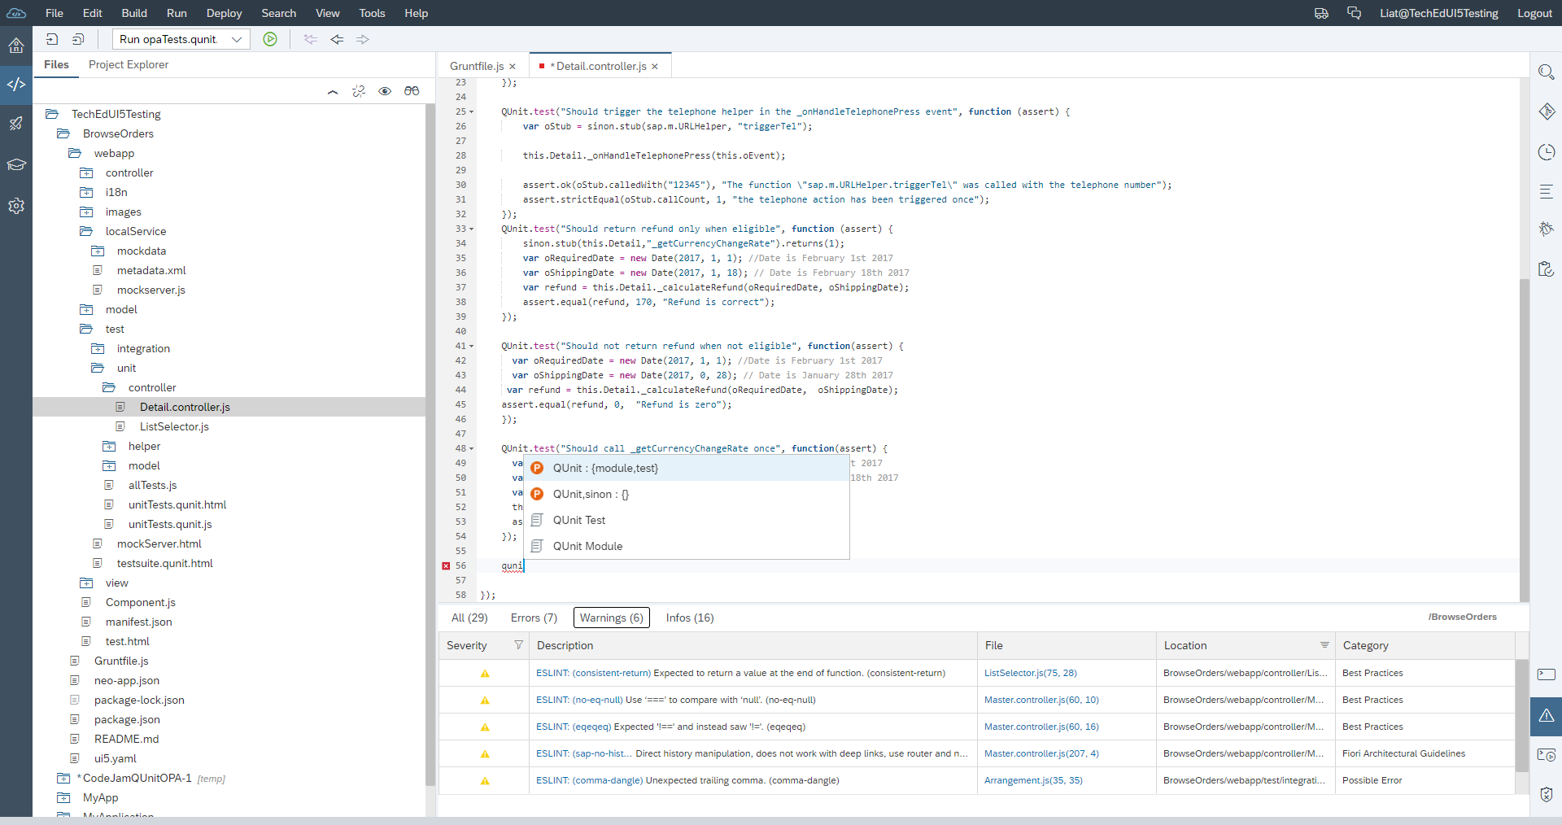

SAP Web IDE
SAP Web IDE is a powerful, extensible, web-based integrated development
It simplifies end-to-end SAP Fiori, SAPUI5, and full-stack SAP business application development
Develop
Test
Build and deploy
Extend apps

Slide 12
SAP Cloud Platform Mobile Services
How to find the best approach
 | Native | Mobile Development Kit | Mobile Cards
Pros | Native look and feel Best performance Instant access to device specific innovations | Native look and feel Visual development approach simplifies development Simplified app development lifecycle Enforces UX consistency | Simple wallet style UX No coding required for SAP Fiori Elements UI
Good For | Apps that require the best mobile UX and performance Offline apps Apps that require native frameworks Example: Field sales, self service, consumer apps | Apps that require the best mobile UX Functionally complex apps Offline apps Apps that require significant and frequent customization Example: Field service, asset maintenance apps | Functionally simple apps Example: Fact sheets, approval apps
Required Skills | Xcode/Swift and Android Studio/Java skills | Mobile Development kit skills | HTML5, CSS skills

Slide 13
Thank you.
Contact information:
Akarsh Sidhartha
Product Manager
SAP Cloud Platform – Mobile Technology
akarsh.sidhartha@sap.com
Sandeep T D S
Product Specialist
SAP Cloud Platform – Mobile Technology
sandeep.tds@sap.com

